Slide 1
Lecture 35

Slide 2

Vacuum
Membrane
Membrane
Gas at T_{i}
Gas at T_{i}

Slide 4
Question 123.10.7
The initial state of a system is shown, if the membrane is broken, the gas fills the entire container. Is there work done by the gas in filling the container?
Yes
No
Can’t Tell
Vacuum
Membrane
Gas at T_{i}

Slide 5
Question 123.17.1
The useful work that comes from and engine is equal to
-w_{on the gas}
Q
ΔE_{int}
PV

Slide 6
Δx
P
F_{gas}
F_{external}
Q
V
V_{i}
V_{f}

Slide 7
Second Law Again: Clausius I
It is impossible to make a cyclical machine that transfers energy spontaneously from a colder object to a hotter object

Slide 8
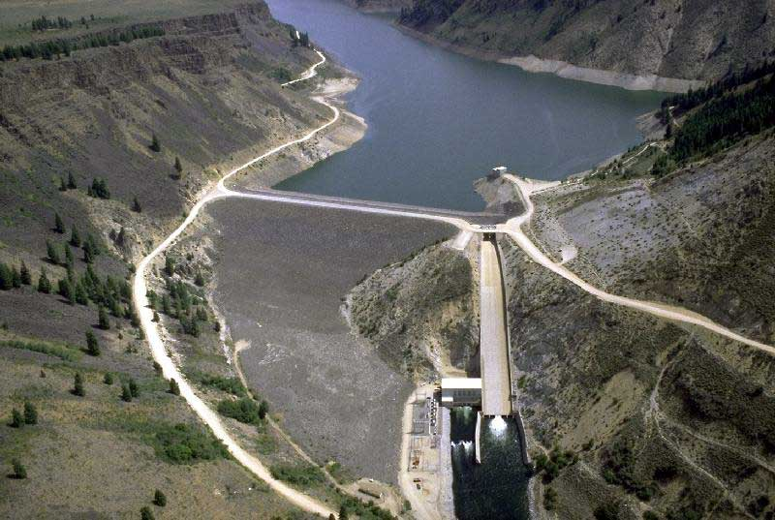
Question
The picture shows the Anderson Ranch Dam and Reservoir.
If I take out a cup of water out of the reservoir, how much do the volume and the pressure of the water change?
Volume goes up, pressure down
Volume goes down pressure goes up
Volume goes down pressure goes down
d) You wouldn’t notice any difference

Slide 9
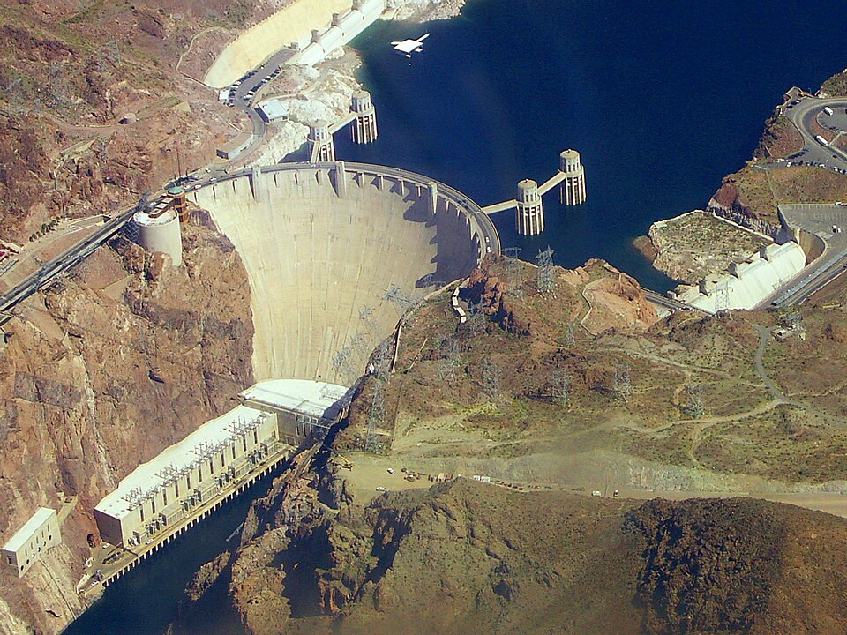

Slide 10
Hot Reservoir at T_{h}
Q_{h}
Q_{c}
Cold Reservoir at T_{c}

Slide 11
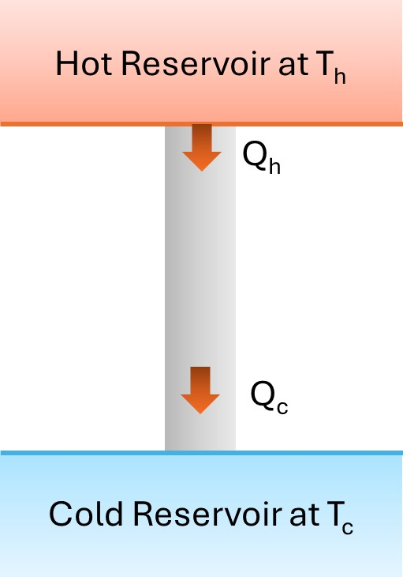
Question 123.17.2
By how much does the temperature of the hot reservoir change as Q_{h} leaves?
0K
10K
100K
1000K

Slide 12
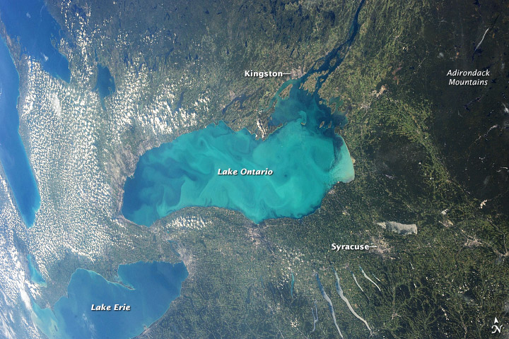
Question: Limit of the Reservoir Model
The picture shows Lake Ontario.
If I deposit a ton of toxic waste a day a hundred thousand other people also deposit a ton of toxic waste a day into the lake, will it affect the state of the lake?
Yes
No
Maybe

Slide 13
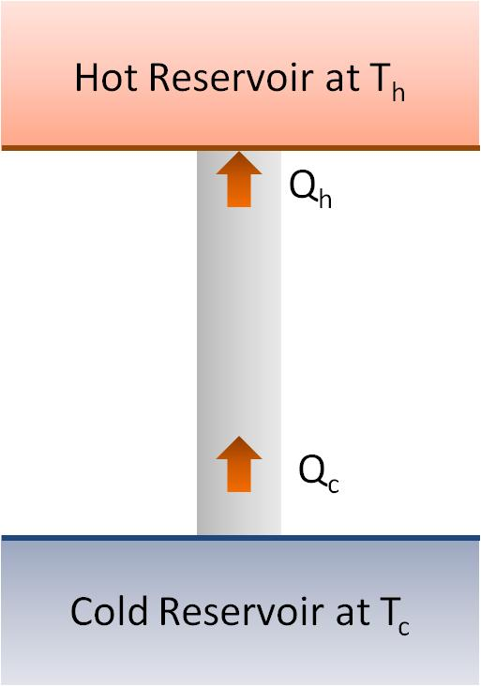
Question 123.17.3
What would you call the process shown in the energy transfer diagram
Adiabatic
Isobaric
Isothermal
Impossible

Slide 14
Question 123.17.4
What does the energy transfer diagram mean?
Heat is turned into useful work
Work is turned into waste energy
Energy is turned into useful work
This is an impossible process

Slide 15
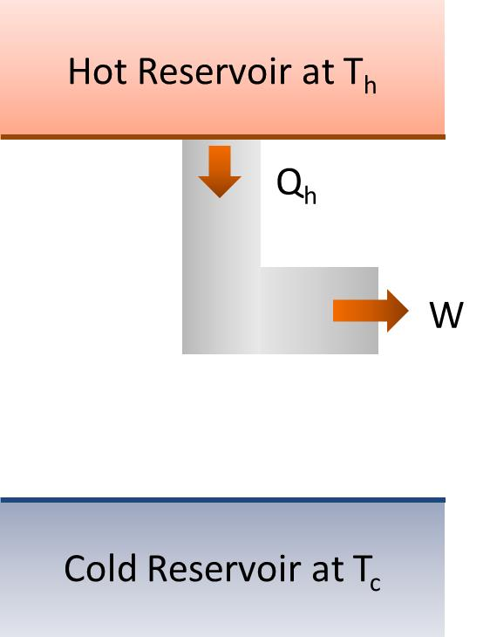
Question 123.17.4.5
What would you call the process shown in the energy transfer diagram
Adiabatic
Isobaric
Isothermal
Impossible

Slide 16
Hot Reservoir at T_{h}
Q_{h}
Engine
W_{engine}
Q_{c}
Cold Reservoir at T_{c}

Slide 17
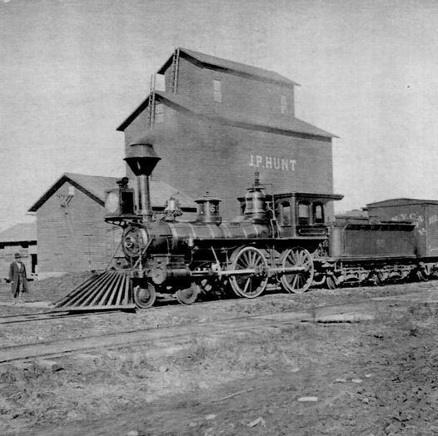

Slide 18
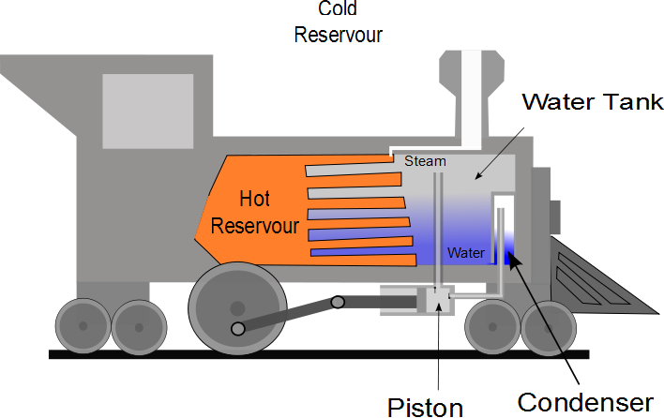
Question
For a steam locomotive, what is the hot reservoir?
The piston
The condenser
The firebox (where the fire is)
The boiler
The air outside the locomotive

Slide 19
Question
For a steam locomotive, what is the cold reservoir?
The piston
The condenser
The firebox (where the fire is)
The boiler
The air outside the locomotive

Slide 21
P
W_{eng} = Area
V

Slide 22
Question 123.17.5
Suppose I tell you I have an engine that has and efficiency e=η=1, what is Q_{c} for this engine?
0
W_{eng}+ Q_{h}
W_{eng}- Q_{h}
W_{eng}

Slide 23
Question 123.17.6
If I tell you I have a heat engine which operates with Q_{c} = 0, what should you do?
Buy Stock in my company
See if you can get your hands on the secret plans
Applaud the wonderful engineering achievement
Tell me I am lying (Kindly, this is BYU-I)

Slide 24
Second Law Again: Kelvin-Plank
It is impossible to construct a heat engine that, operating in a cycle, inputs energy by heat from a hot reservoir and converts the energy entirely into useful work.

Slide 25
Question 123.17.7
It is a hot day. You don’t have and air conditioner, but you have a refrigerator. You open the door of the fridge. The air in your apartment
Gets cooler
Gets hotter
Stays the same
Can’t tell

Slide 26
Hot Reservoir at T_{h}
Q_{h}
Refrigerator
W
Q_{c}
Cold Reservoir at T_{c}

Slide 27
Second Law Again: Clausius II
It is impossible to construct a cyclical machine whose sole effect is to transfer energy continuously by heat from one object to another object at a higher temperature without the input of energy by work.

Slide 29
Hot Reservoir at T_{h}
Q_{h}
Q_{c}
Cold Reservoir at T_{c}

Slide 30
Hot Reservoir at T_{h}
Q_{h}
Q_{c}
Cold Reservoir at T_{c}

Slide 31
Question 123.17.7
It is a hot day. You don’t have and air conditioner, but you have a refrigerator. You open the door of the fridge. The air in your apartment
Gets cooler
Gets hotter
Stays the same
Can’t tell

Slide 32
Hot Reservoir at T_{h}
W
Q_{c}
Cold Reservoir at T_{c}

Slide 33
Hot Reservoir at T_{h}
Q_{h}
W
Cold Reservoir at T_{c}

Slide 34
Hot Reservoir at T_{h}
Q_{h}
W
Cold Reservoir at T_{c}

Slide 35
Hot Reservoir at T_{h}
Q_{h}
Engine
W_{engine}
Q_{c}
Cold Reservoir at T_{c}

Slide 36
Hot Reservoir at T_{h}
Q_{h}
Engine
W_{engine}
Cold Reservoir at T_{c}

Slide 37
Hot Reservoir at T_{h}
Q_{h}
Engine
W_{engine}
Cold Reservoir at T_{c}

Slide 38
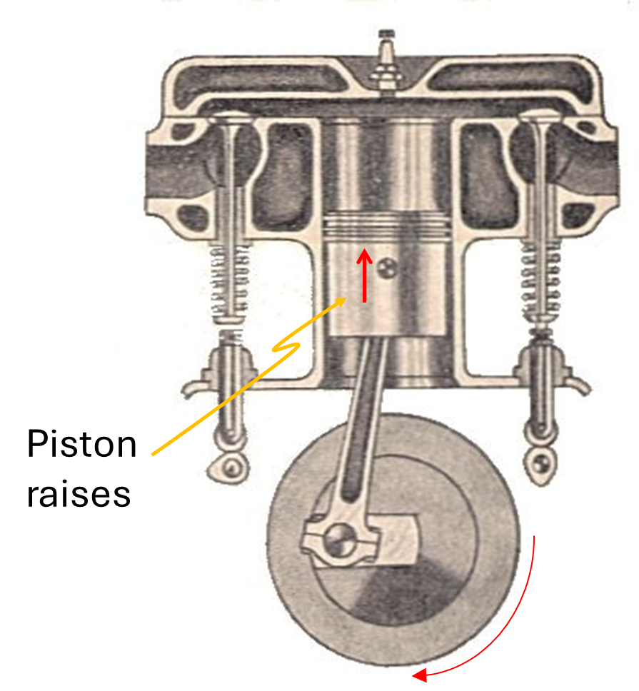
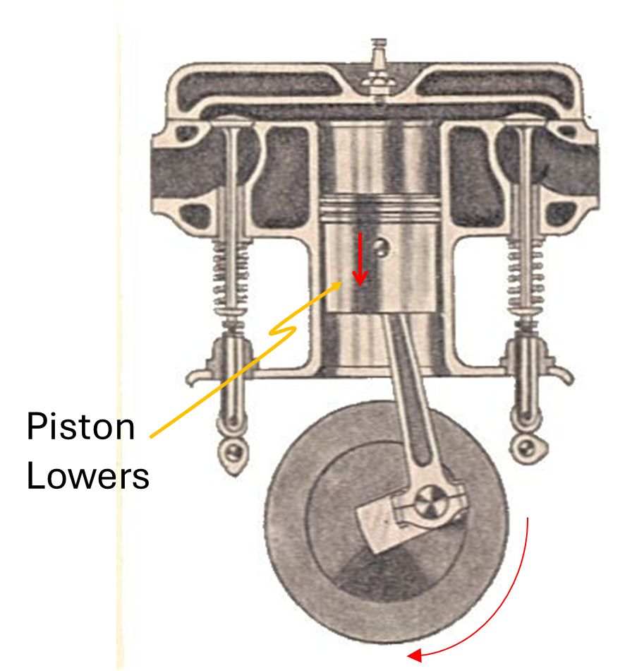
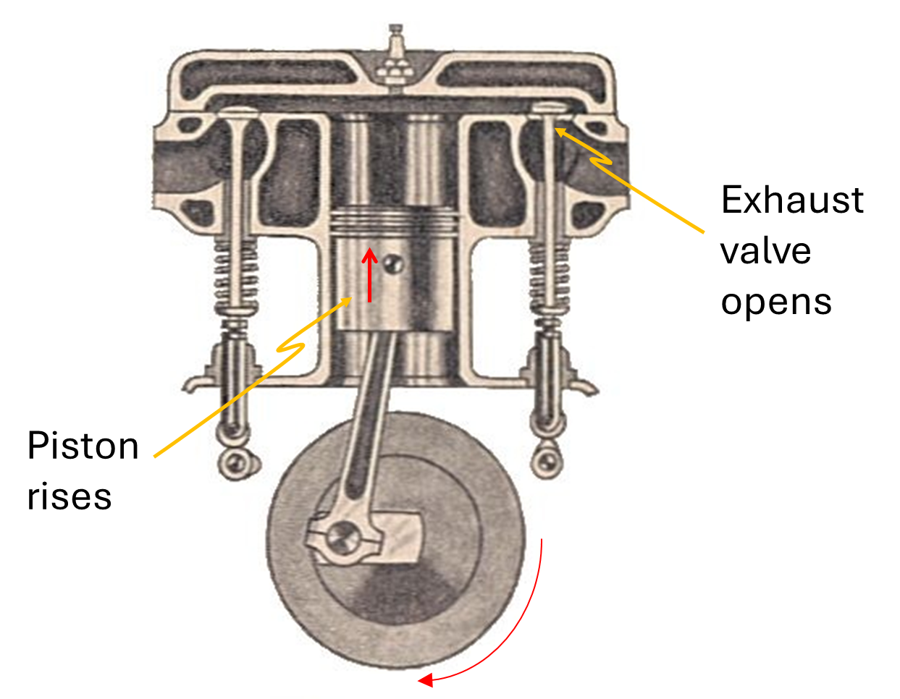
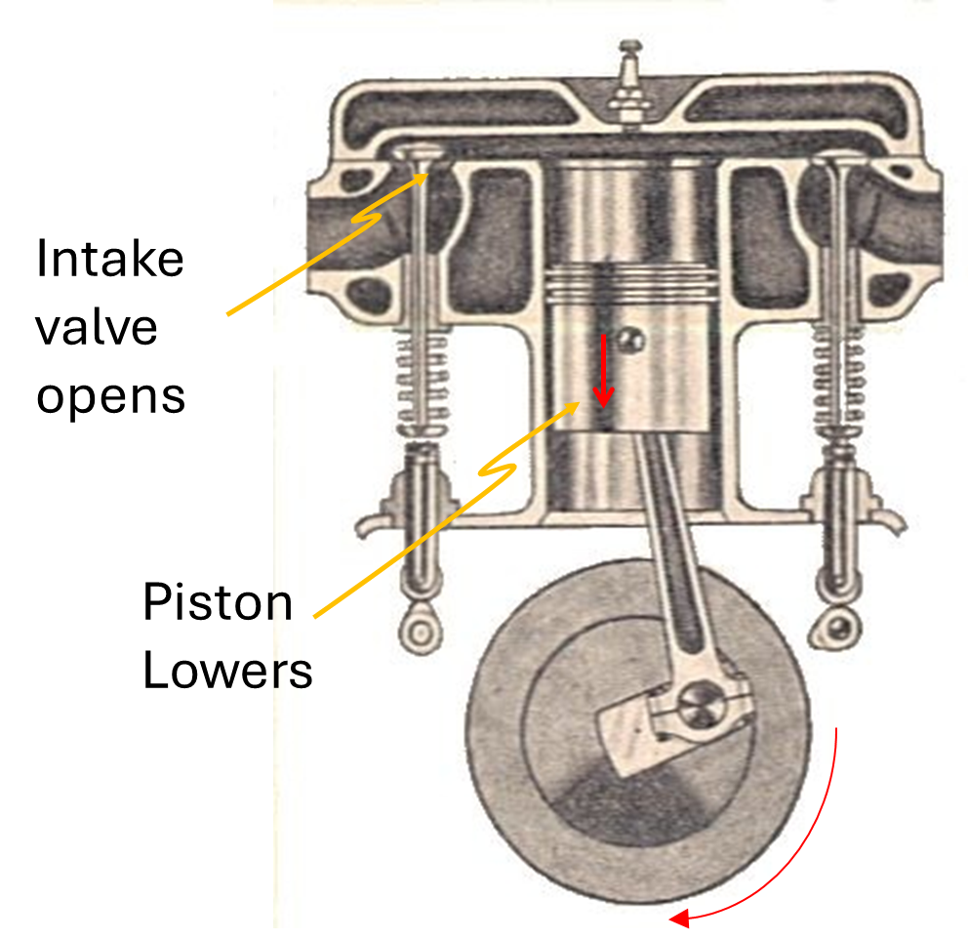
Process AB
Process CD (Power Stroke)
Process AI
Process IA
Otto Cycle
Manual of Driving and Maintenance for Mechanical Vehicles (Wheeled)

Slide 39
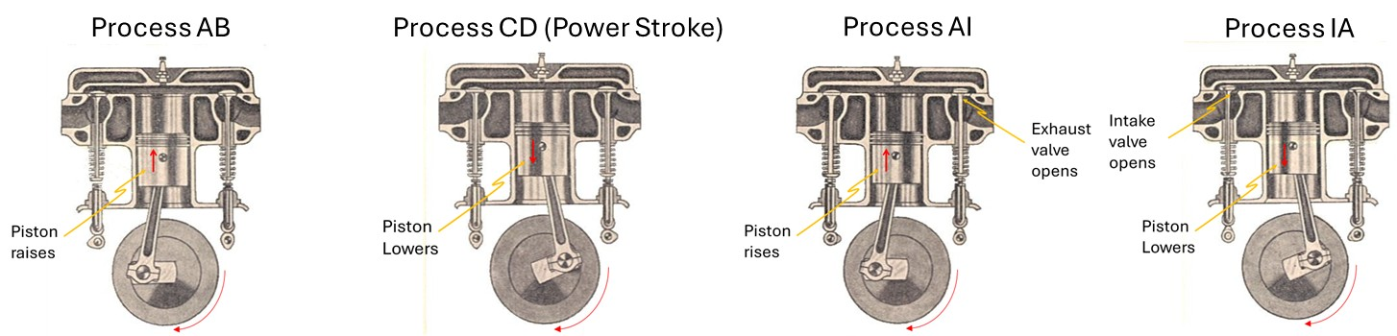
C
B
Pressure (Pa)
D
I
A
Volume (m³)

Slide 40
END

Slide 41
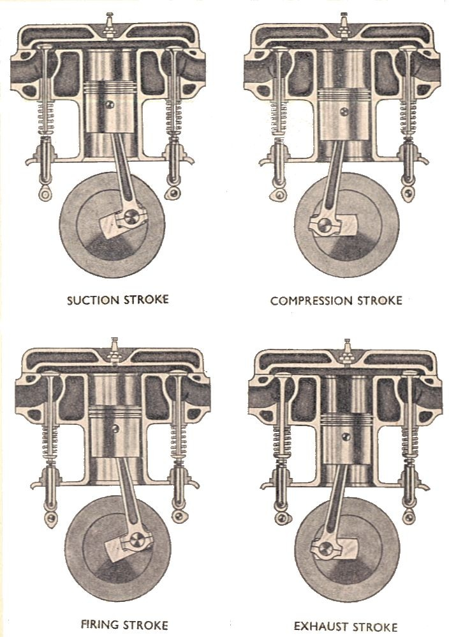
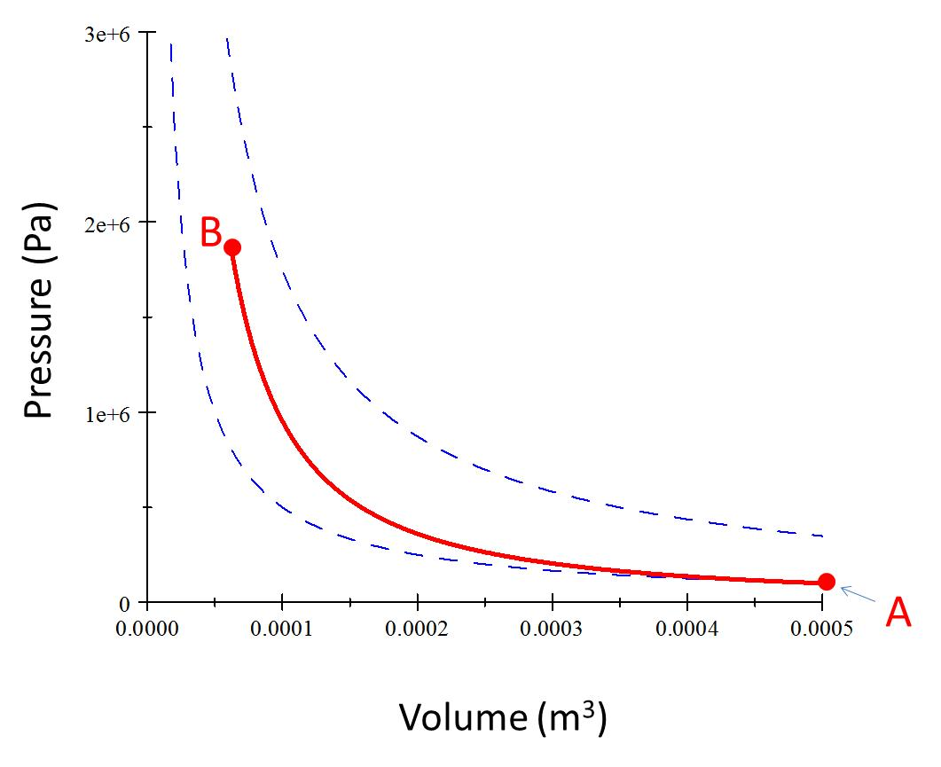
Process AB – Adiabatic Compression
Piston raises

Slide 43
C
B
Pressure (Pa)
Volume (m³)

Slide 44
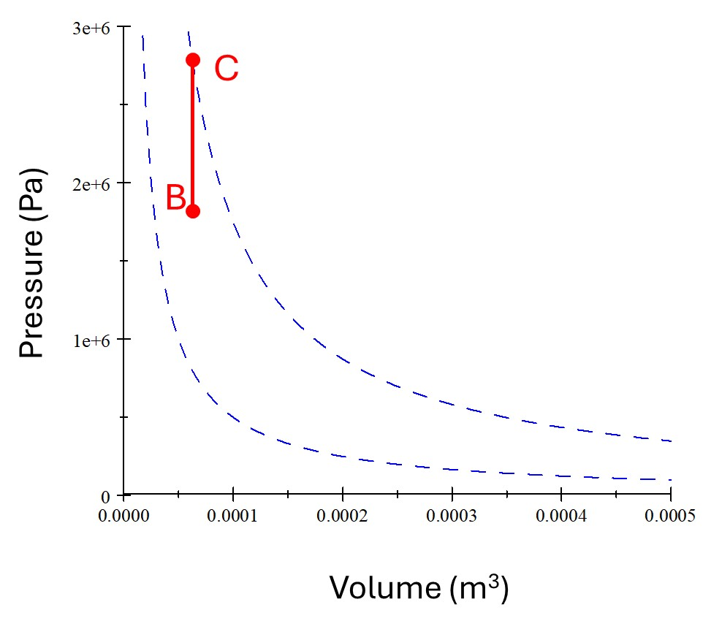

Slide 45
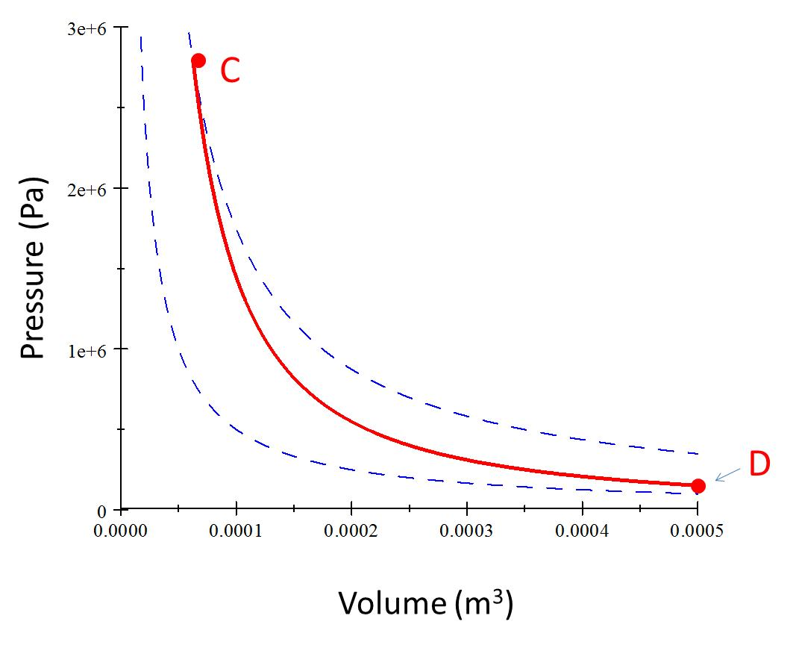
Process CD (Power Stroke)
Piston Lowers

Slide 47
Pressure (Pa)
D
A
Volume (m³)

Slide 48
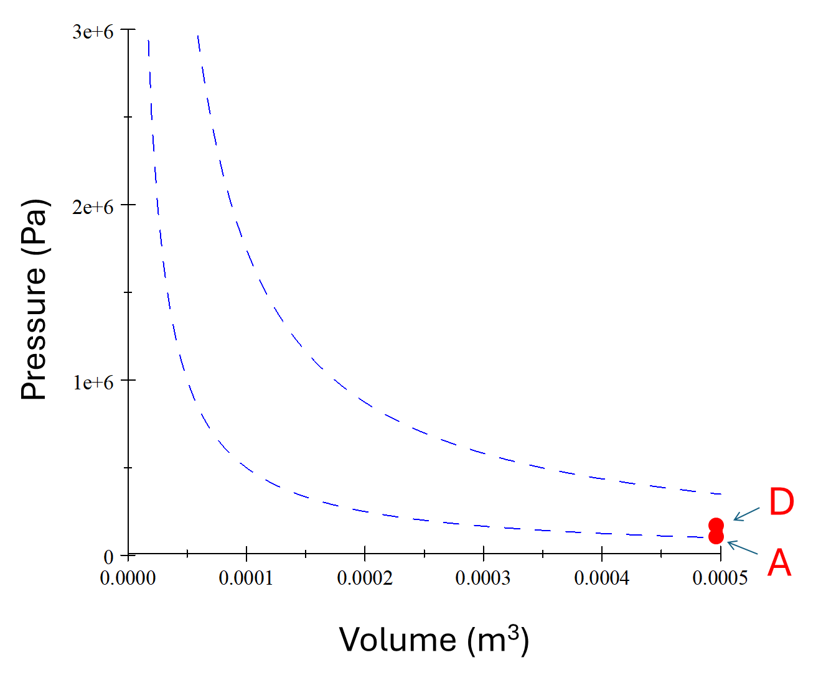

Slide 49
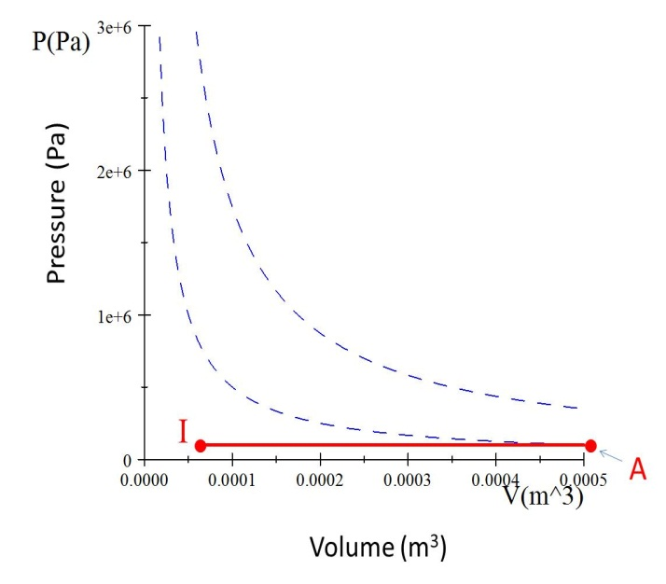
Process AI
Exhaust valve opens
Piston rises

Slide 51
Process IA
Intake valve opens
Piston Lowers

Slide 53
C
Q_{h}
B
Pressure (Pa)
Work Required
Useful Work Out
D
I
Q_{c}
A
Volume (m³)

Slide 54
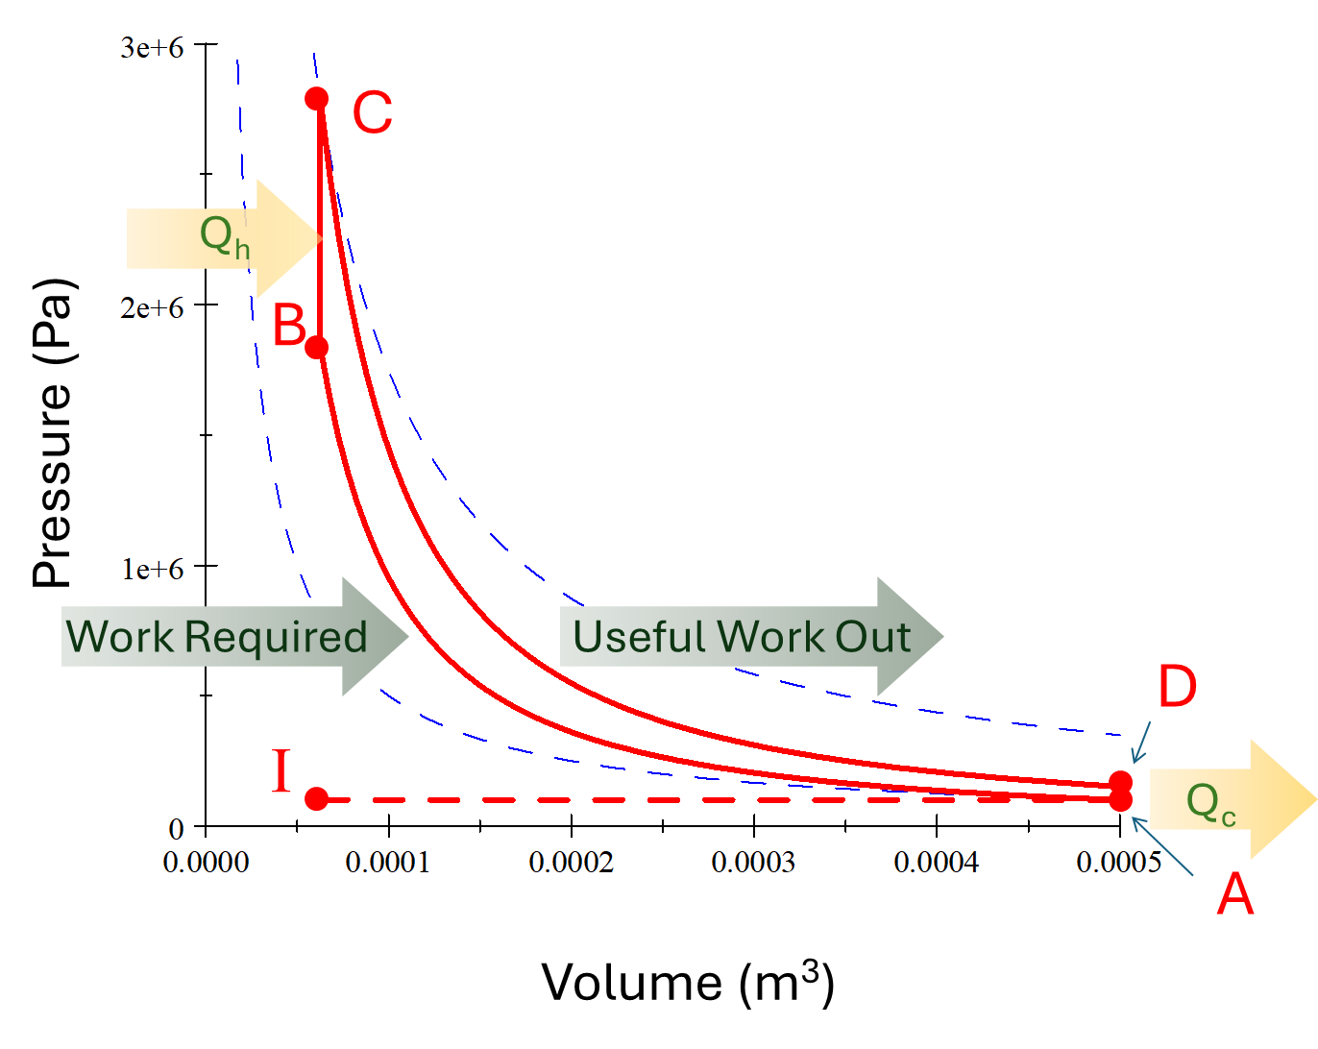

Slide 55
B
Pressure (Pa)
A
Volume (m³)

Slide 56
C
Pressure (Pa)
D
Volume (m³)

Slide 57
Pressure (Pa)
I
A
Volume (m³)

Slide 60
Process IA
Intake valve opens
Piston Lowers

